Slide 1
DES Algorithm
Submitted By
Mehak ( 2018MCS2143)

Slide 2
System SPECIFICATION
OS = Linux
Language used = C++
Input = 16 char plaintext in hexadecimal, 16 char key in hexadecimal
Output = Keys for 16 rounds (in hex), Ciphertext after each round of encryption (in hex), Plaintext after each round of decryption (in hex).

Slide 3
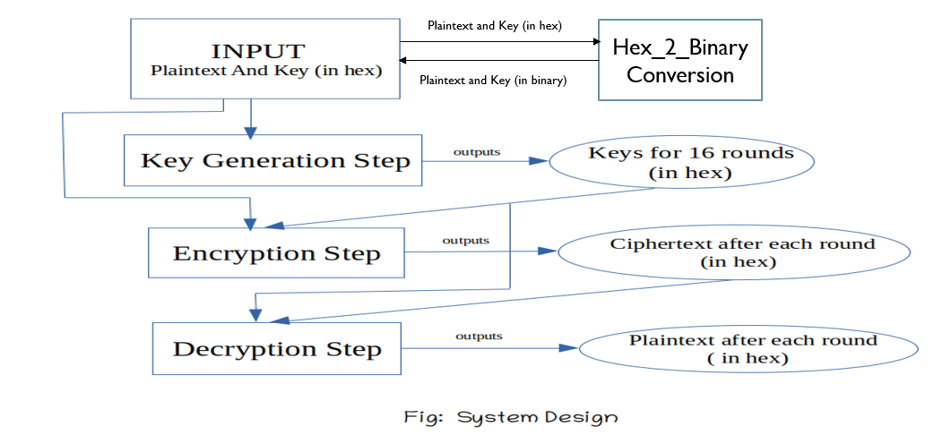
SYSTEM DESIGN

Slide 4
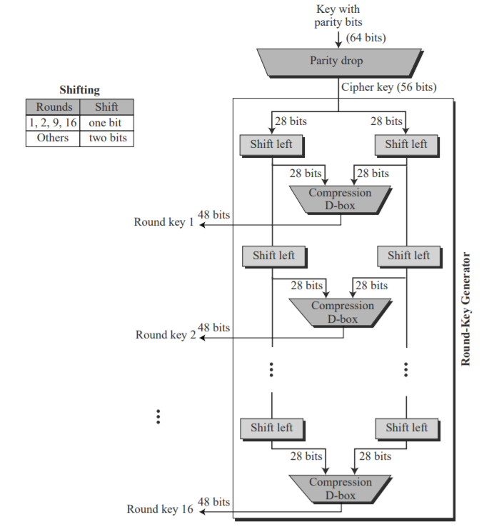
KEY Generation step
Img ref: Internet

Slide 5
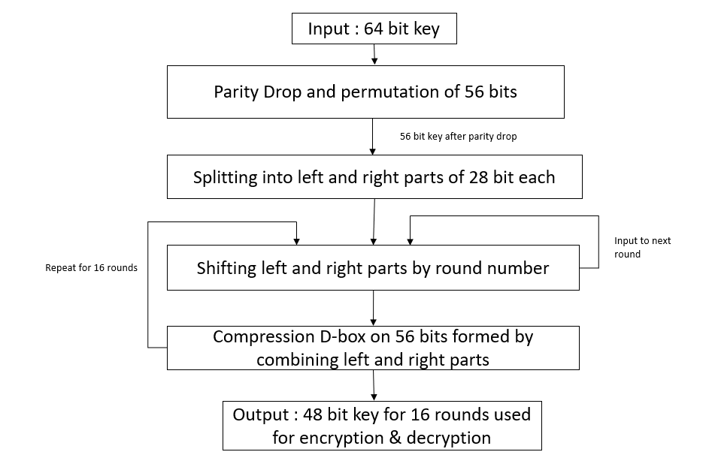
Key generation in system

Slide 6
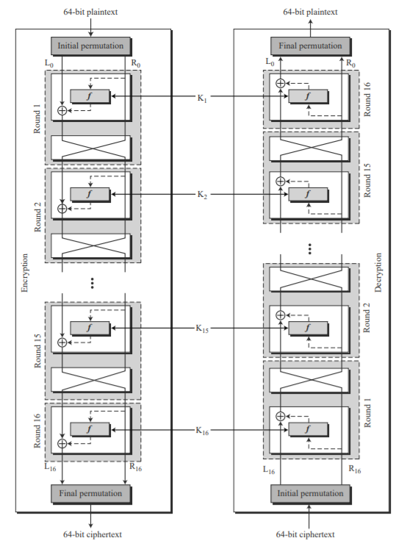
Encryption & DECRYPTION step
Img ref:
Internet

Slide 7
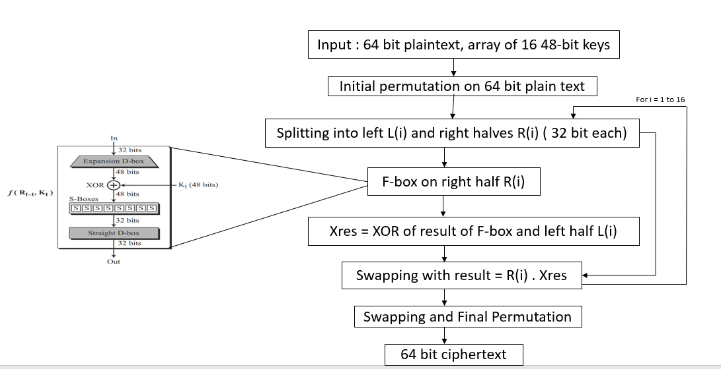
Encryption step in system

Slide 8
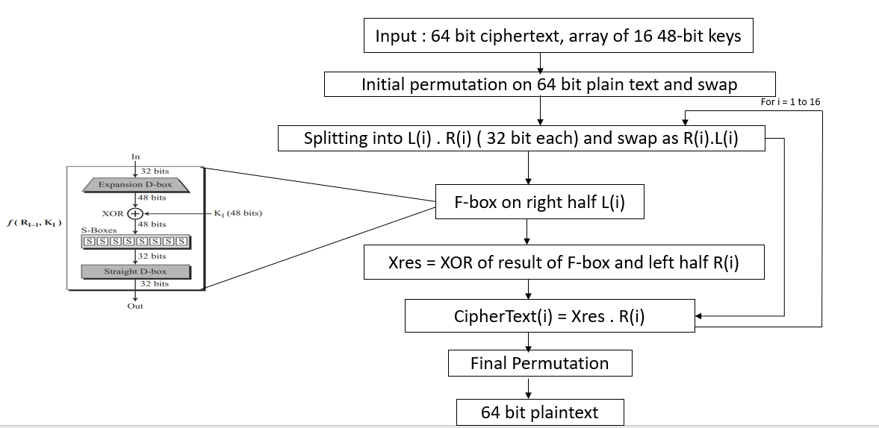
decryption step in system

Slide 9
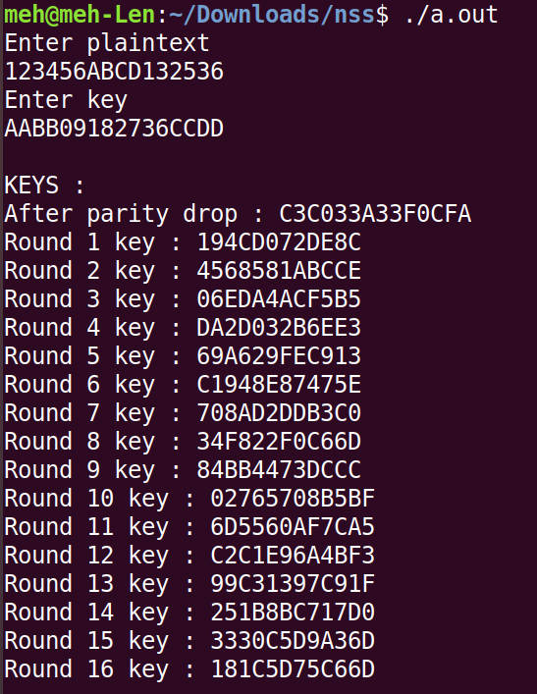
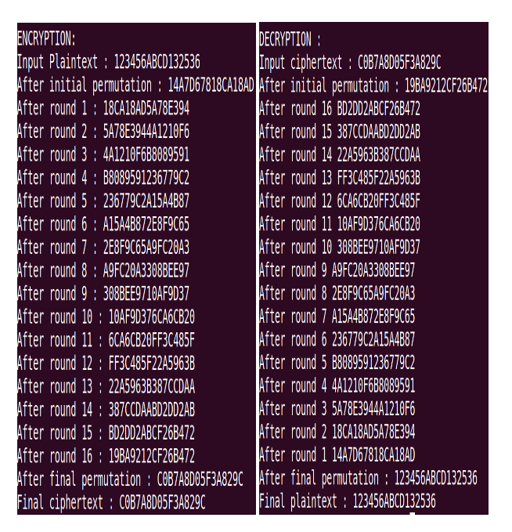
Example of des system

Slide 10
PROPERTIES
Avalanche Effect :
Avalanche effect means a small change in the plaintext (or key) should create a signifi cant change in the ciphertext. DES has been proved to be strong with regard to this property.
Completeness Effect:
Completeness effect means that each bit of the ciphertext needs to depend on many bits on the plaintext. The diffusion and confusion produced by D-boxes and S-boxes in DES, show a very strong completeness effect.

Slide 11
Weaknesses
Key Size : Critics believe that the most serious weakness of DES is in its key size (56 bits). To do a brute-force attack on a given ciphertext block, the adversary needs to check 256 keys.
Weak Keys and Semi-weak keys : Four out of 256 possible keys are called weak keys. A weak key or semi weak key can be easily found by the adversary using their properties.

Slide 12
Security of des
Brute-Force Attack :
DES can be broken using 255 encryptions. However, most applications use either 3DES with two keys
(key size of 112) or 3DES with three keys (key size of 168) that makes DES resistant to brute-force attacks.
Differential Cryptanalysis :
The designers of DES designed S-boxes and choose 16 as the number of rounds to make DES specifically
resistant to this type of attack.
Linear Cryptanalysis :
DES is more vulnerable to linear cryptanalysis probably because it was not known to the designers of DES.
S-boxes are not very resistant it. DES can be broken using 243 pairs of known plaintexts which is practically
very unlikely.

Slide 13
Thank You
Ref : Textbook and Internet

